Slide 1
Introduction to Java for Business BU350.700.51 Spring I 2025
Basic Input & Output

Slide 2
More About println() & print()
System.out.println( “Java rocks!!” );
Method Name
Argument List
System.out.print( “Java rocks!!” );
Same as System.out.println() without linefeed

Slide 3
Output Basics
public class OutputDemo1
{
public static void main( String [] args )
{
int x = 10;
System.out.println(); // Just prints linefeed
System.out.println( “Java rocks” );
System.out.print( “The value of x is “ );
System.out.println( x ); // Prints 10 in string form
}
}

Slide 4
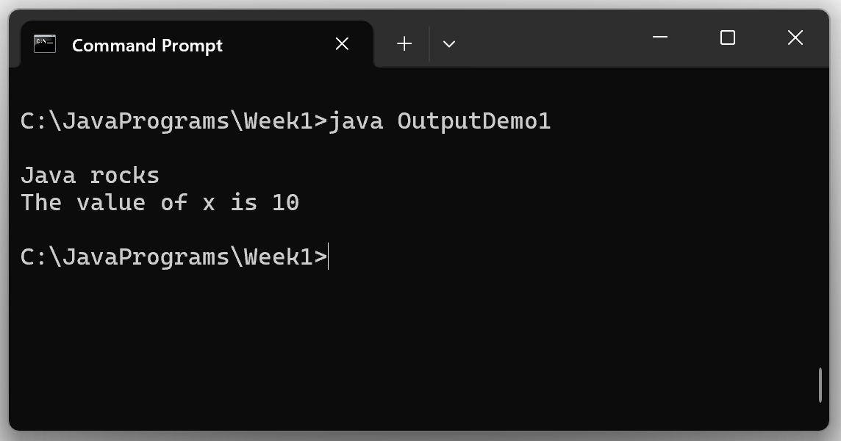
Output Basics

Slide 5
Output Basics
public class OutputDemo2
{
public static void main( String [] args )
{
int x = 10;
int y = 20;
System.out.println();
System.out.println( “x is “ + x + “ and y is “ + y );
System.out.println( “x + y is “ + x + y );
}
}
+ concatenates parts of the string

Slide 6
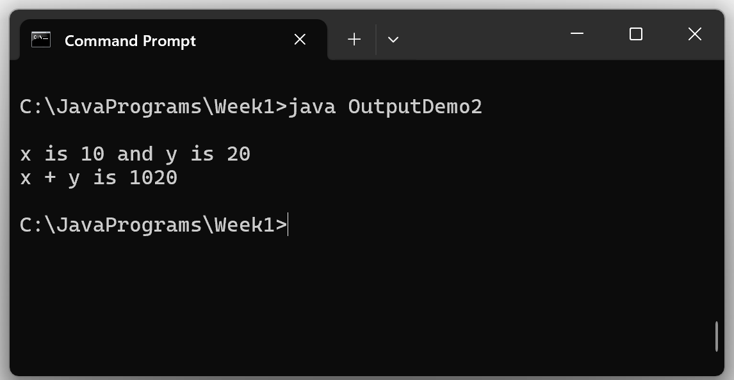
Output Basics

Slide 7
Output Basics
public class OutputDemo3
{
public static void main( String [] args )
{
int x = 10;
int y = 20;
System.out.println();
System.out.println( “x + y is “ + x + y );
System.out.println( “x + y is “ + ( x + y ) );
}
}
result is: x + y is 1020
Parentheses around x + y causes the compiler to perform numerical addition

Slide 8
Compile & Run This Program
public class OutputDemo3
{
public static void main( String [] args )
{
int x = 10;
int y = 20;
System.out.println();
System.out.println( “x + y is “ + x + y );
System.out.println( “x + y is “ + ( x + y ) );
}
}

Slide 9
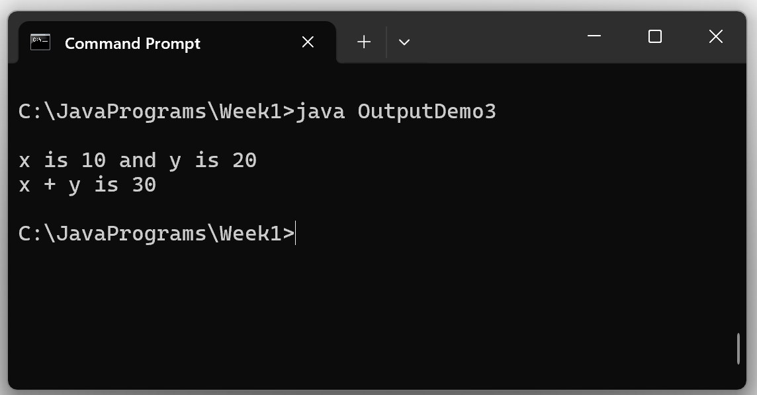
Sample Program Output

Slide 10
Escape Sequences
Escape Sequence | Name | Description
\b | Backspace | Moves the screen cursor one character to the left.
\t | Tab | Moves the screen cursor to the next tab position.
\n | Linefeed or Newline | Moves the screen cursor to the beginning of the next line.
\r | Carriage Return | Moves the screen cursor to the beginning of the current line.
\\ | Backslash | Used to display a backslash (\) character.
\’ | Single Quote | Used to display a single quote character.
\” | Double Quote | Used to display a double quote character.

Slide 11
Displaying Quotation Marks
Joe said “Java is cool”
System.out.println( “Joe said “Java is cool” “ );
Java compiler thinks the second quotation mark ( “ ) ends the argument list…and it doesn’t know what to do with the remaining quotation marks…so it generates a compiler error
System.out.println( “Joe said \“Java is cool\” “ );
Use escape sequences…now it works

Slide 12
Using printf()
printf() is used to do formatted output
System.out.printf( “%s%n%s%n”, “Java“, “Rocks!!” );
Method Name
Format String
Argument List
%s is a placeholder for a string %n generates a linefeed
System.out.println( “Java” );
System.out.println( “Rocks!!” );
Same result using println()

Slide 13
Using printf()
public class FormattedPrintDemo
{
public static void main( String [] args )
{
int anInteger = 12345;
float aFloat = 123456.789F;
System.out.println();
System.out.println("PRINTING INTEGERS");
System.out.printf("%d%n%10d%n", anInteger, anInteger);
System.out.println();
System.out.println("PRINTING FLOATS");
System.out.printf("%.2f%n%12.2f%n%-12.3f%n%,12.3f%n", aFloat, aFloat, aFloat, aFloat);
}
}

Slide 14
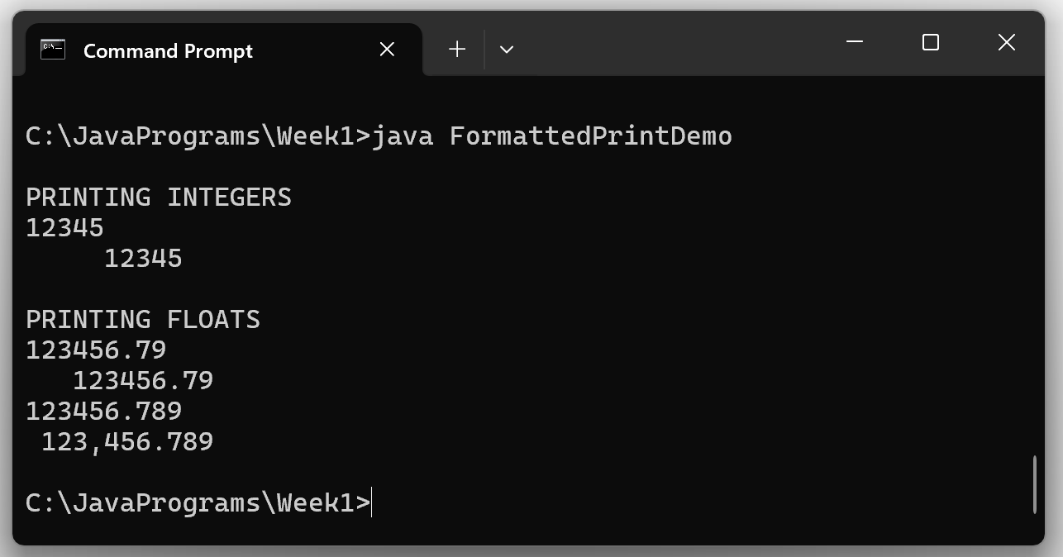
Sample Program Output

Slide 15
Getting User Input
An easy way to get user input is to use the Java Scanner class. It contains methods that can be used to input various data types and automatically convert them to their binary form.
Scanner can also be used to input data from files, but for now we will focus on user input from the keyboard.

Slide 16
Getting User Input
import java.util.Scanner; // import the Scanner class
public class ScannerDemo
{
public static void main( String [] args )
{
int anInteger;
float aFloat;
// create a Scanner to read from keyboard
Scanner input = new Scanner( System.in );
// prompt user for input
System.out.print( "Please enter an integer followed by a float: " );
anInteger = input.nextInt();
aFloat = input.nextFloat();
System.out.println( "You entered " + anInteger + " and " + aFloat );
}
}
By default Scanner uses white space as a delimiter

Slide 17
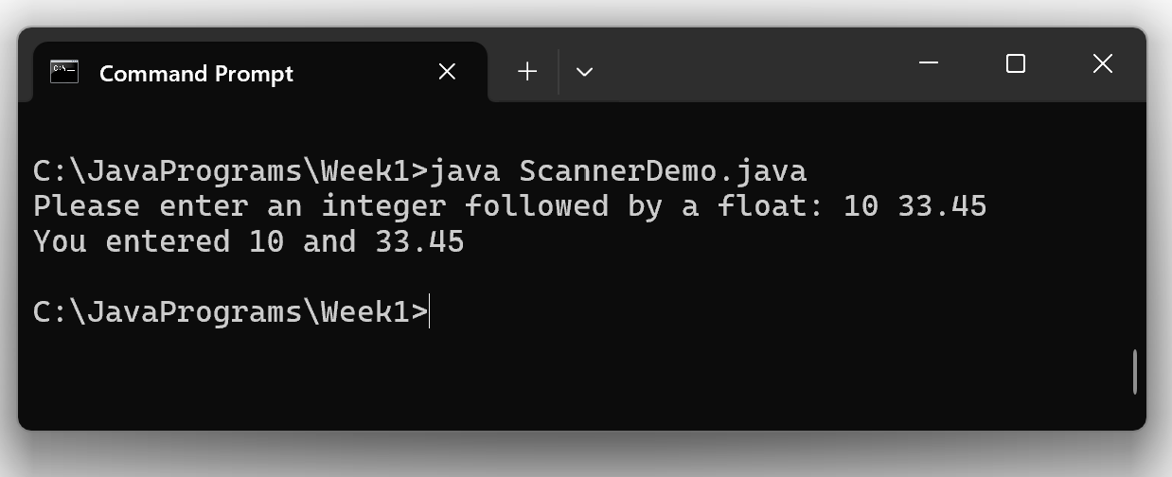
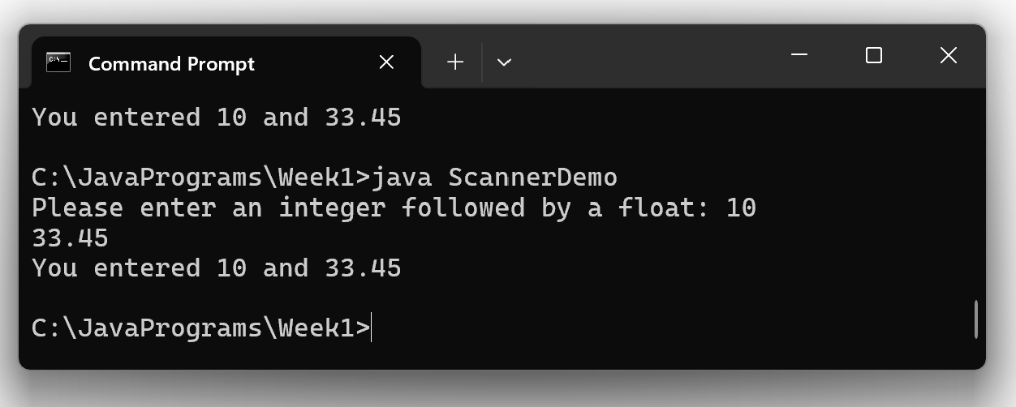
Getting User Input

Slide 18
Getting User Input
Checking to see if next input item is the correct data type
import java.util.Scanner; // import the Scanner class
public class ScannerDemo2
{
public static void main( String [] args )
{
int anInteger = 0;
float aFloat = 0F;
// create a Scanner to read from keyboard
Scanner input = new Scanner( System.in );
// prompt user for input
System.out.print( "Please enter an integer followed by a float: " );
if( input.hasNextInt() ) // returns true if next input item is an int
anInteger = input.nextInt();
else
System.out.println( "Expected integer input not found" );
if( input.hasNextFloat() ) // returns true if next input item is a float
aFloat = input.nextFloat();
else
System.out.println( "Expected float not found" );
System.out.println( "You entered " + anInteger + " and " + aFloat );
}
}

Slide 19
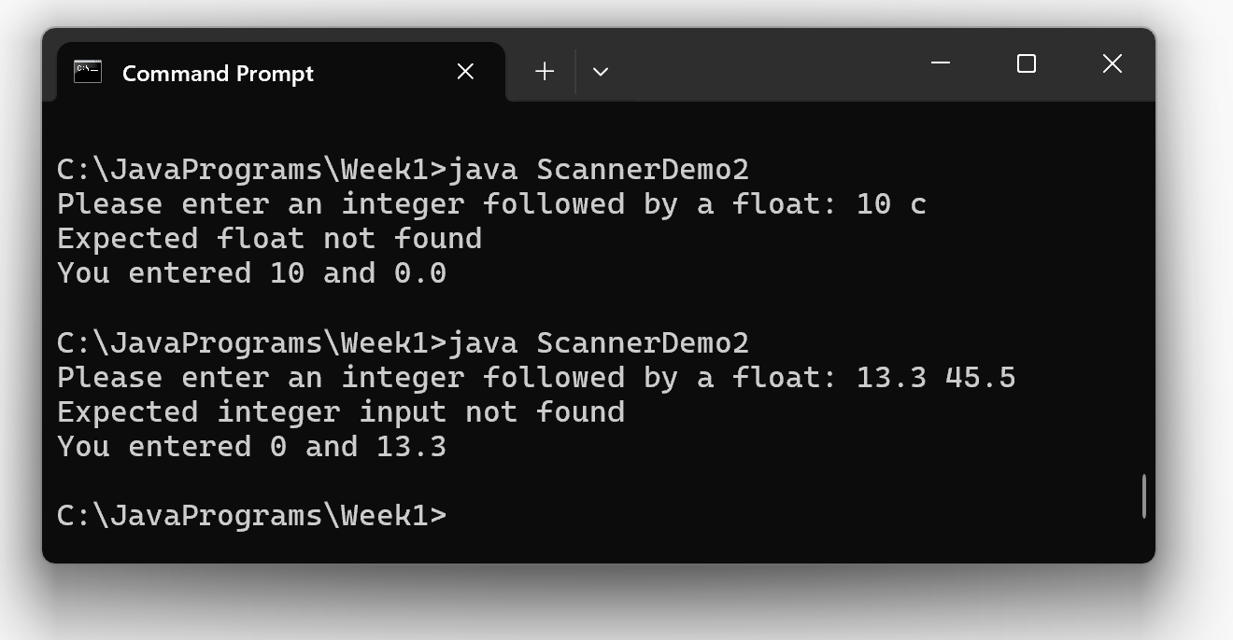
Getting User Input
Checking to see if next input item is the correct data type
Note that 45.5 is still in the input stream

